Slide 1
Blackbox techniques
Prepared by: Radoslaw Poswiata
04 November 2016
Version: 1.0

Slide 2

Agenda
Black Box Testing Introduction
Domain Testing Process
Use Case Testing
Summary
Additional materials
https://github.com/jacekokrojek/math.uni.lodz.pl

Slide 3
Black Box Testing Introduction
Black Box (behavior) Testing:
Group of techniques which are focused on functional / non-functional behavior of DUT (Device under test) without to reference to its internal structure
Tests are designed basing on:
Specification
Requirements
Design parameters
Other like: product’s market, risk, environment (hardware and software)
Some authors narrow this concept to testing exclusively against an authoritative specification
Main Testing approaches:
Domain Testing
Use Case Testing

Slide 4
Domain testing process
Characterize the variable
Identify potentially interesting variables
Identify primary dimension of the variable (type and scale)
Analyze variables and create tests
Partition the variable
Identify secondary dimension (danger cases)
Analyze function
Analyze relations between variables
Analyze output variables

Slide 5
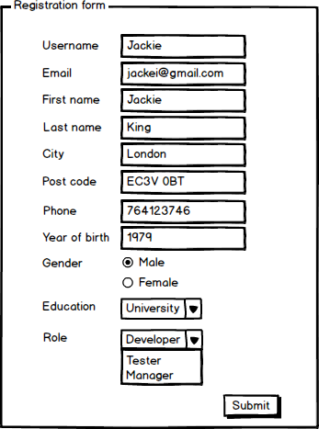
Domain testing process – Primary Dimention
Characterize the variable
Identify primary dimension of the variable (type and scale)
Identify potentially interesting variables
Primary Dimensions:
String
Number (Intiger / Float)
Enumeration
File

Slide 6
Domain testing process – Characterize Variable
Characterize the variable
Identify primary dimension of the variable (type and scale)
Identify potentially interesting variables
In case of enumeration Fields each possible value of the variable require one test
Gender (2), Education (3), Role (3)
Input Text Box (e.g. Year of brith)
Primary dimension : number
Length : 4
Intresting Values:
String
Special characters
How many Tests?

Slide 7
Domain testing process – Analyze variables and create tests
Analyze variables and create tests
Partition the variable
Identify secondary dimension (danger cases)
Post codes | Partition
N1C 4AA, K1C 4AB, W4C 4AD, V1C 4AE, NW7 1AB, EC2 1FD, ... | UK
00-982, 01-987, 05-300, 95-200, 90-890, ... | Poland
... | ...
Other | Invalid
Equivalence partitioning (also called Equivalence Class Partitioning or ECP) is a software testing technique that divides the input data of a software unit into partitions of equivalent data from which test cases can be derived. In principle, test cases are designed to cover each partition at least once.
ECP technique is usually applied when values of the variable can not be ordered
Each equivalence class requires one test case

Slide 8
Domain testing process – Analyze variables and create tests
Analyze variables and create tests
Partition the variable
Identify secondary dimension (danger cases)
People under 18. can not register
0
17
Boundary value analysis is a software testing technique in which tests are designed to include representatives of boundary values in a range. The idea comes from the boundary. Given that we have a set of test vectors to test the system, a topology can be defined on that set.
For each boundary on and off value requires test case (Beizer, Black-Box Testing)
More powerful then ECP when values of the variable can be ordered.
18
User name may contain up to 20 characters (including).
0
20

Slide 9
Domain testing process – Analyze variables and create tests
Boundary-Equivalence table is used to analyze to present cases that should be testes.
Below table presents analysis for username variable that should contain only [a-zA-ZółśćńźąężŁÓŚĆŃĄĘŻŹ] characters and not be longer then then 20 characters
Description | Is valid Case | Boundry and special cases | Notes
# characters 1-20 [a-zA-ZółśćńźąężŁÓŚĆŃĄĘŻŹ] | YES | a
 | YES | zAZZółśćńźąężŁÓŚĆŃĄ | To cover all chars except ĘŻŹ
 | YES | aĘŻŹbBcCdDeEfFgGhHiI | To cover ĘŻŹ
# characters > 20 | NO | ĘŻŹbBcCdDeEfFgGhHiIja
# characters = 0 (empty) | NO
^[a-zA-ZółśćńźąężŁÓŚĆŃĄĘŻŹ] | NO | @ | Before A in ASCII
 | NO | [ | After Z in ASCII
 | NO | ` | Before a in ASCII
 | NO | { | After z in ASCII

Slide 10
Domain testing process – Analyze variables and create tests
Analyze variables and create tests
Partition the variable
Identify secondary dimension (danger cases)
Secondary Dimension contains cases which are not defined by stockholders and expected by developer
This helps to protect product from intended or not intended values
For each common variable type there are catalogs of such potentially danger variables that can help in test design.

Slide 11
Domain testing process – Analyze variables and create tests
Additional cases should be also stored in Boundary-Equivalence table
Description | Is valid Case | Boundry and special cases | Notes
Regular expressions | NO | *
 | NO | .+
 | NO | ?.+
Non printable characters | NO | \\n | Double escaped newline
 | NO | \n | Single escaped newline
XSS | NO | <script ... /> | Simplest XSS
SQL Injection | NO | ' OR '1'='1 | Simplest SQL
 | NO | Space

Slide 12
Domain testing process – Analyze functions
Analyze function
Analyze relations between variables
Analyze output variables
All Singles is a approach to testing multiple variables together. It requires that each equivalence class/boundary for each variable should be tested at least once.
It is not important in which case certain value is tested
Considering following parameters
P1: A1, B1, C1
P2: A2, B2, C2
P3: A3, B3, C3
3 Tests Cases are required to meet requirements
P1 | P2 | P3
A1 | A2 | A3
B1 | B2 | B3
C1 | C2 | C3

Slide 13
Domain testing process – Analyze functions
Analyze function
Analyze relations between variables
Analyze output variables
All Singles is a approach to testing multiple variables together. It requires that each equivalence class/boundary for each variable should be tested at least once.
It is not important in which case certain value is tested
Considering following parameters
P1: A1, B1, C1
P2: A2, B2, C2
P3: A3, B3, C3
and
A1, B2, A3 are typically entered by user
Still only 3 cases needed to satisfy this requirement
P1 | P2 | P3
A1 | B2 | A3
B1 | A2 | B3
C1 | C2 | C3

Slide 14
Domain testing process – Analyze functions
Analyze function
Analyze relations between variables
Analyze output variables
All Singles is a approach to testing multiple variables together. It requires that each equivalence class/boundary for each variable should be tested at least once.
It is not important in which case certain value is tested
Considering following parameters
P1: A1, B1, C1
P2: A2, B2, C2
P3: A3, B3, C3
and
A1, B2, A3 and A1, A2, B3
are typically entered by user
Additional case is required
P1 | P2 | P3
A1 | B2 | A3
A1 | A2 | B3
B1 | A2 | B3
C1 | C2 | C3

Slide 15
Domain testing process – Analyze functions
Analyze function
Analyze relations between variables
Analyze output variables
P1 | P2 | P3
C1 | C2 | B3
A1 | C2 | C3
A1 | A2 | A3
B1 | A2 | C3
A1 | A2 | C3
A1 | A2 | B3
A1 | C2 | B3
C1 | C2 | A3
A1 | B2 | C3
C1 | B2 | A3
B1 | C2 | A3
C1 | B2 | C3
B1 | B2 | B3
A1 | B2 | A3
C1 | B2 | B3
C1 | C2 | C3
A1 | C2 | A3
C1 | A2 | A3
B1 | A2 | A3
B1 | B2 | C3
B1 | B2 | A3
C1 | A2 | B3
B1 | A2 | B3
A1 | B2 | B3
B1 | C2 | B3
B1 | C2 | C3
C1 | A2 | C3
All N-Tuples is an approach that requires to test each variable in combination with each other variable
Considering following parameters
P1: A1, B1, C1
P2: A2, B2, C2
P3: A3, B3, C3
we need 27 cases

Slide 16
Domain testing process – Analyze functions
Analyze function
Analyze relations between variables
Analyze output variables
Considering following parameters
P1: A1, B1, C1
P2: A2, B2, C2
P3: A3, B3, C3
we need 10 cases
All Pair is an approach that requires us to test all combination of pairs of variables.
It is based on the study showing that more then 90% of error in software are caused by of two or more parameters.
This approach can be extended to all triples etc.
P1 | P2 | P3
C1 | A2 | A3
C1 | C2 | B3
A1 | C2 | C3
B1 | B2 | C3
C1 | B2 | B3
A1 | B2 | A3
C1 | A2 | C3
A1 | A2 | B3
B1 | C2 | A3
B1 | A2 | B3
PICT tool is very helpful when generation test cases using this approach
PICT Tool - http://download.microsoft.com/download/f/5/5/f55484df-8494-48fa-8dbd-8c6f76cc014b/pict33.msi
PICT Tool information - https://msdn.microsoft.com/en-us/library/cc150619.aspx

Slide 17
Domain testing process – Analyze functions
Analyze function
Analyze relations between variables
Analyze output variables
AP1 | AP2 | AP3
A1 | A2 | B3
B1 | A2 | B3
B1 | A2 | A3
A1 | B2 | B3
B1 | B2 | A3
A1 | A2 | A3
B1 | B2 | B3
A1 | B2 | A3
A1 | ~C2 | A3
B1 | B2 | ~C3
~C1 | B2 | A3
~C1 | A2 | A3
A1 | A2 | ~C3
A1 | ~C2 | B3
A1 | B2 | ~C3
~C1 | A2 | B3
~C1 | B2 | B3
B1 | ~C2 | B3
B1 | A2 | ~C3
B1 | ~C2 | A3
Each System/Component deliver some results/outputs basing on delivered input variables
Output variables should be analyzed in the similar way to input variables and we should make sure all classes/boundaries are verified.
Considering following component:
AP1: A1, B1, ~C1
AP2: A2, B2, ~C2
AP3: A3, B3, ~C3
We need 20 cases to satisfy All N-tuples assuming that incorrect parameters are not tested together.

Slide 18
Domain testing process – Analyze functions
Analyze function
Analyze relations between variables
Analyze output variables
In case when invalid values of different variables cause the same result (i.e. the same error message is displayed if user enters invalid username or first name) only one invalid value should be checked during the test.
Decision Table Technique helps to reduce number of tests in more complicated input/output relations. This approach can be easily used as use case techniques
AP | Valid / Invalid Case
1 | A1/B1 | A1/B1 | A1/B1 | A1/B1 | ~C1 | ~C1 | ~C1 | ~C1
2 | A2/B2 | A2/B2 | ~C2 | ~C2 | A2/B2 | A2/B2 | ~C2 | ~C2
3 | A3/B3 | ~C3 | A3/B3 | ~C3 | A3/B3 | ~C3 | A3/B3 | ~C3
OK | X
Error 1 |  | X | X | X
Error 2 |  |  |  |  | X | X | X | X

Slide 19
Use case testing
Use cases are common method to describe system functions.
A use cases specifies a sequence of actions, including variants, that the system can perform and that yields an observable result of value to a particular actor
Each use cases should be covered at least by one test however usually one test case in not enough.
Concepts within the use case:
Actor: a person, process or external system that interacts with your product.
Action: An action results in a change of state and is realized by sending a message to an object or modifying a value in an attribute.
Goal: The goal is to reach a desired state of the system.

Slide 20
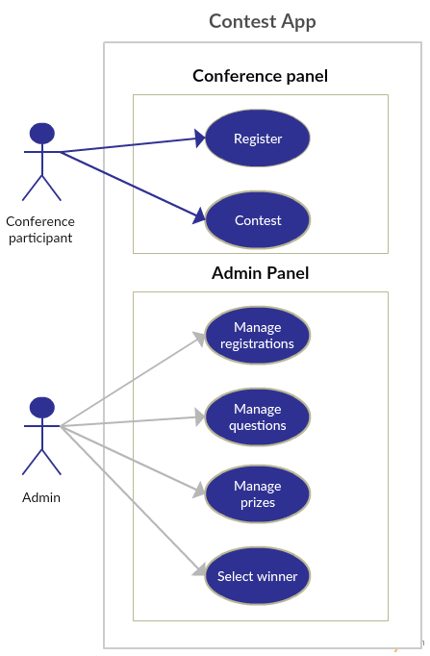
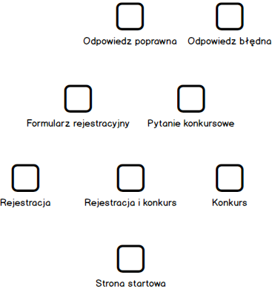
Use case testing
Use cases can be defined as
Informal text
Using Alistair Cockburn template
Flow chart
State diagrams

Slide 21
Use case testing
In case of informal text
Brainstorm and list the primary actors
Brainstorm and exhaustively list user goals for the system (Positive Cases)
Capture the summary goals (higher-level goals, which include several sub-goals. These capture the meaningful benefits offered by the system).
Select one use case to expand.
Capture stakeholders and interests, preconditions and guarantees.
Write the main success scenario.
Brainstorm and exhaustively list extension conditions (such as alternate sequences to achieve the same result, or sequences that lead to failure.)
Use Case: Register
Goal in Context: Conference participant would like to stay in touch with potential employer
Preconditions: No
Success End Condition: Contact details stored
Failed End Condition: Contact details not stored
MAIN SUCCESS SCENARIO
1. Participant press 'Stay in touch'
2. Participant enters all his contact details
3. Participant submits form
EXTENSIONS
2a. Invalid email address
2a1. Pop up is shown
3a. Candidate abort action

Slide 22
Scenario based testing
A scenario is a coherent story about how someone uses (or tries to use) the program.
A scenario test uses a scenario as a tool for evaluating a program’s behaviour. The elements of the story (adapted from Carroll, 1999)
Setting
Agents or actors
Goals or objectives
Motivations and emotions
Plot (sequences of actions and events)
Actions & events can change the goals
Sample scenario: Contest application should help in building company new image on a large testing conference. Valuable prizes should attract many participants that may use application at the same time.
Set up enough questions for big number of participants.
Check if application is fast enough when many users access it at the same time
Verify if exporting huge number of registration to excel works as expected.
Varify that users can easily discover how to use application.
Varify that application can display large images of main prizes.

Slide 23
Scenario based testing
KAHN'S LIST OF BENEFITS OF SCENARIO BASED THINKING
Call attention to the larger range of possibilities that must be considered in the analysis of the future
Dramatize and illustrate the possibilities
Force analysts to deal with details and dynamics that they might avoid if they focus on abstract considerations
Illuminate interactions of psychological, social, economic, cultural, political, and military factors, including the influence of individual personalities ... in a form that permits the comprehension of many interacting elements at once.
Consider alternative possible outcomes of certain real past and present events

Slide 24
Scenario based testing
Ideal scenario test has several characteristics:
The test is based on a coherent story about how the program is used, including goals and emotions of people.
The story is credible. Stakeholders will believe that something like it probably will happen
The story is motivating. A stakeholder with influence will advocate for fixing a program that failed this test.
The story involves complexity: a complex use of the program or a complex environment or a complex set of data.
Test results are easy to evaluate. This is important for scenarios because they are complex.
Many test techniques tell you how the program will behave in the first few days that someone uses it.
Good scenario tests go beyond the simple uses of the program to ask whether the program is delivering the benefits it should deliver
Good scenarios often give you insight into frustrations that an experienced user will face - someone who has used the program for a few months and is now trying to do significant work with the program

Slide 25
Tractability matrix
Tractability matrix is used in order to make sure that all use cases are covered by tests.
Each uses case should be mentioned in the tractability matrix and at least one test cases should test each use case
 | TC_1 | TC_2 | TC_3 | TC_4 | TC_5
Contest | x | x
Registrations |  |  | x
Prizes |  |  |  | x
Lotery |  |  |  |  | x
Notes:
Create test cases

Slide 26
Testing in the software life
Early testing and testing approaches
Structural tests - Developer creates class or function
Domain testing – Part of the module is ready
Use case testing – Module is ready
Scenario based testing – System is ready
Early testing allows for more detailed and cost effective testing
Imagine scenario with several steps that needs to be executed several times to cover all variants of inputs
It is difficult to avoid testing some cases at many levels – it is usually more efficient to check such cases many times then to find strategy to avoid double checking.

Slide 27
Thank you!

